Slide 1


Data analysis of ”Porto de Mos” integrated supermarket
Presenter:
Vahid Khorshidi

Slide 2
Porto de Mos supermarket PID:

Slide 3
Scope :
- System efficiency in different modes
Power consumption
Ejector performance.
Challenges :
Missing mass flow meter for ejector suction and motive
Low quality of mass flow meters data during specific weeks
Low frequency of data acquisition
Approach :
Identify accurate data measurement
Develop a data driven model of the systems ( and individual components) to generate missing data for analysis
Comparison and utilization of given function for individual components (compressors , valves)

Slide 4
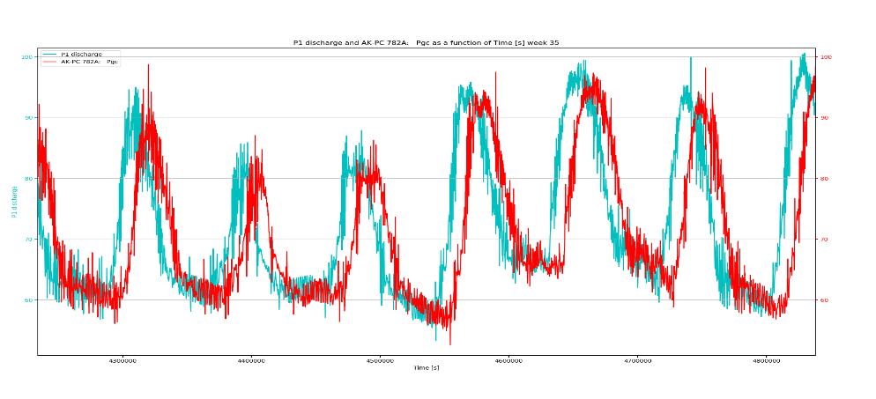
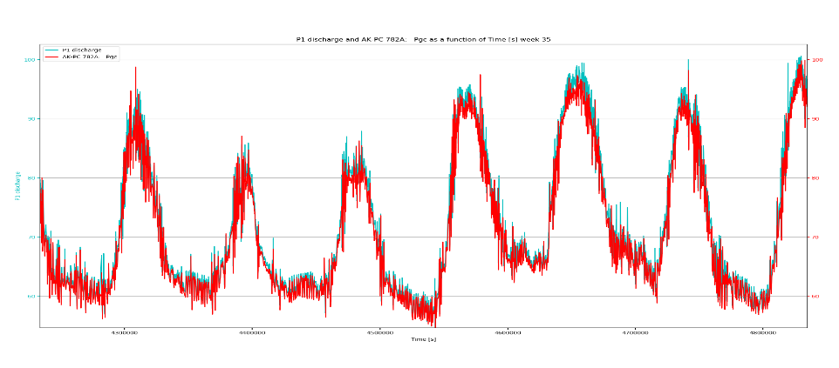
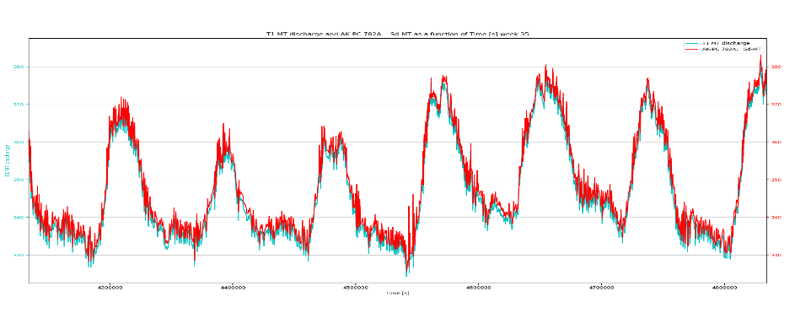
Challenges on combining CNR and Danfoss data
Data verification and comparison
Date acquisition time
CNR :1 min
Danfoss controller: 2 min
Best case data from two sources is 15 (s) apart:
11/07/2019 17:14:45 sample from CNR
11/07/2019 17:15:00 sample from Danfoss
Pressure at MT discharge
Time lag corrected
Temperature and pressure log measured shows the absolute times of one source is not matching with real time.
Based on several T and P comparison at same sensor position, a time lag for each week is calculated and applied to synchronize data.
Measurement from both sources contained some rows of “NaN”, “Not recorded”, “Missing” or “0” values that should be taken out from both data sets to keep times synced.
Temperature at MT discharge
Time refrence for datetime conversion to seconds (t0) for all graphs is ”17:00:00 11/07/2019” (datetime format: " %H:%M:%S %d/%m/%Y”)

Slide 5
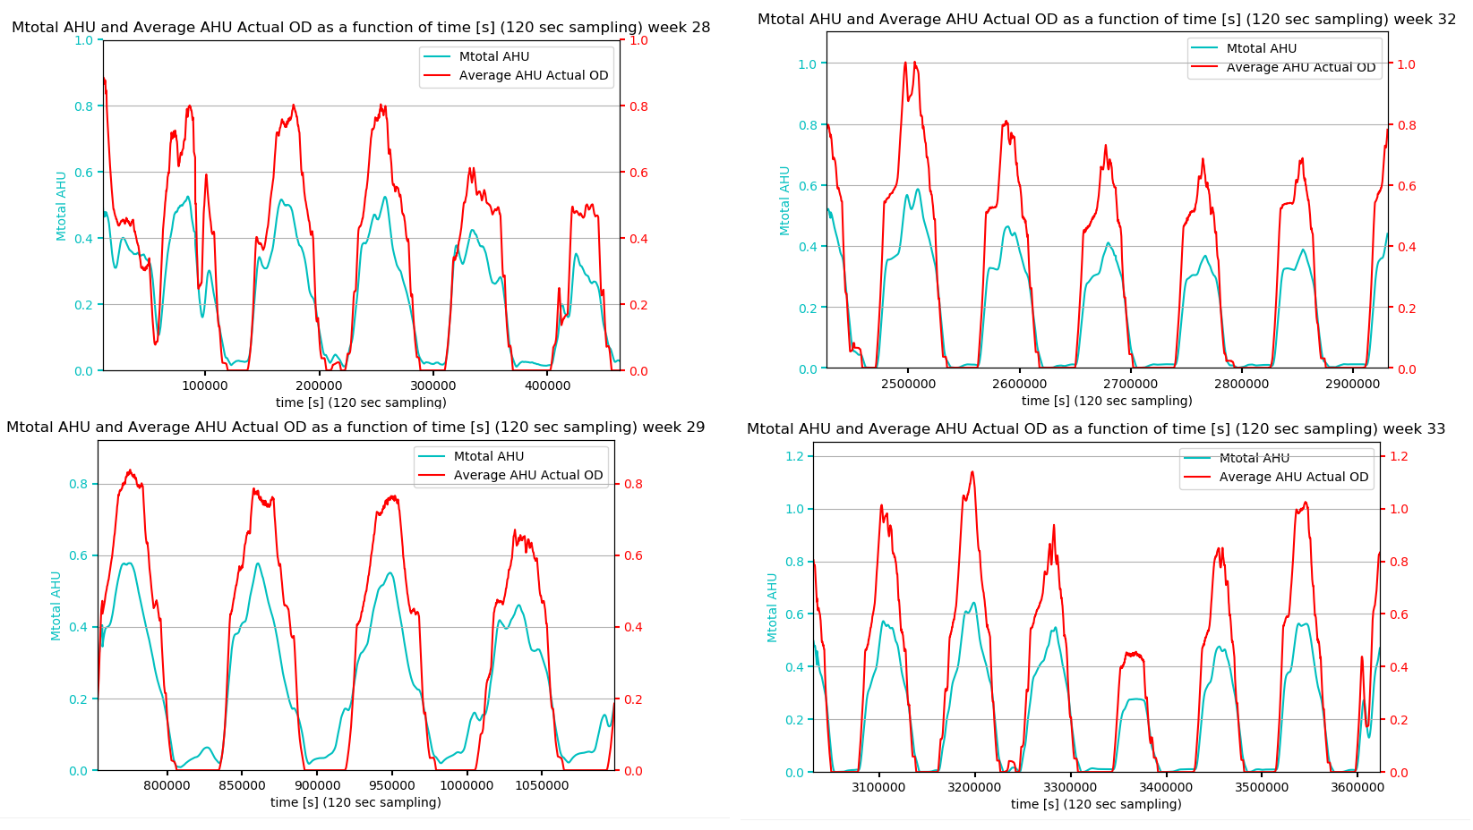
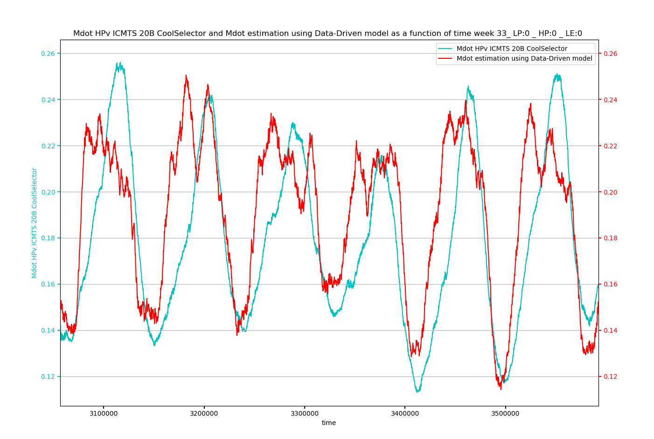
Challenges on combining CNR and Danfoss data
AC mass flow rate(M1 and M5) comparison with “CCMT16” expansion valve opening degrees and CoolSelector® functions.
High pressure valve mass flow rate was estimated using motor operated high pressure valve “ICMTS 20-B” using CoolSelector® function. Compared with week 33.(No ejector mode)
Time refrence for datetime conversion to seconds (t0) for all graphs is ”17:00:00 11/07/2019” (datetime format: " %H:%M:%S %d/%m/%Y”), 180 min moving average.

Slide 6
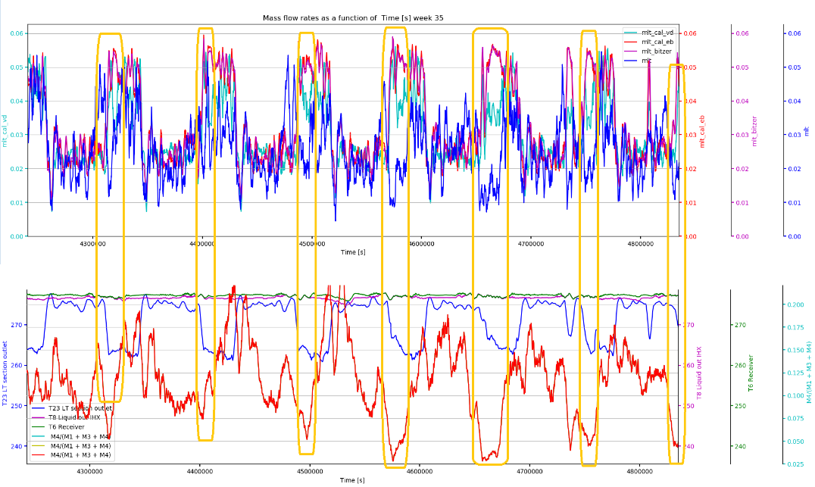
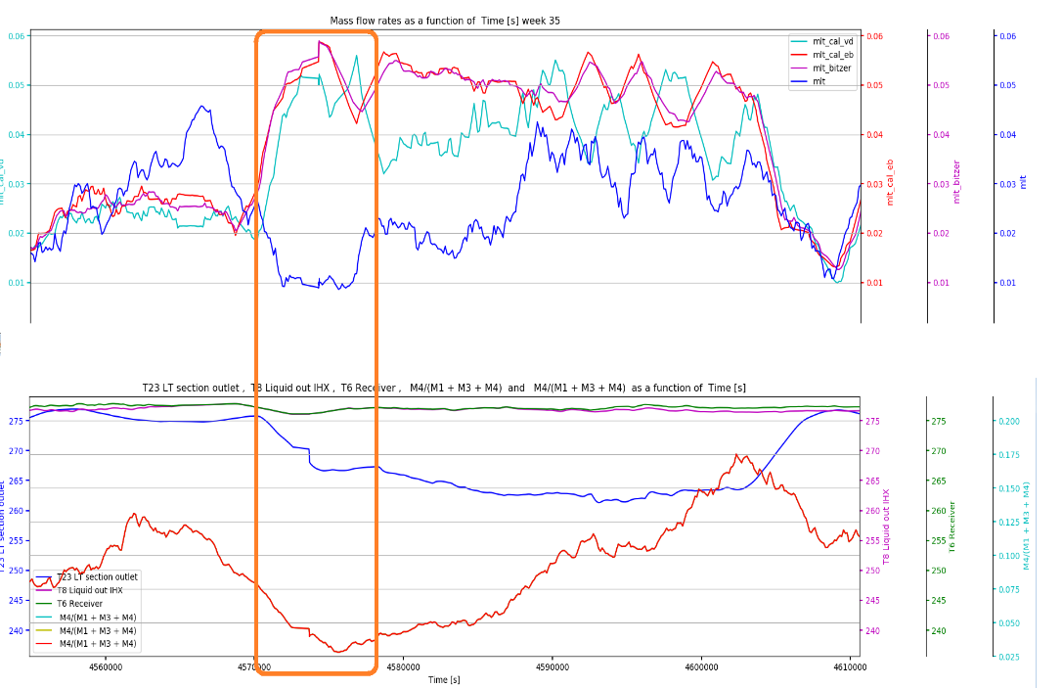
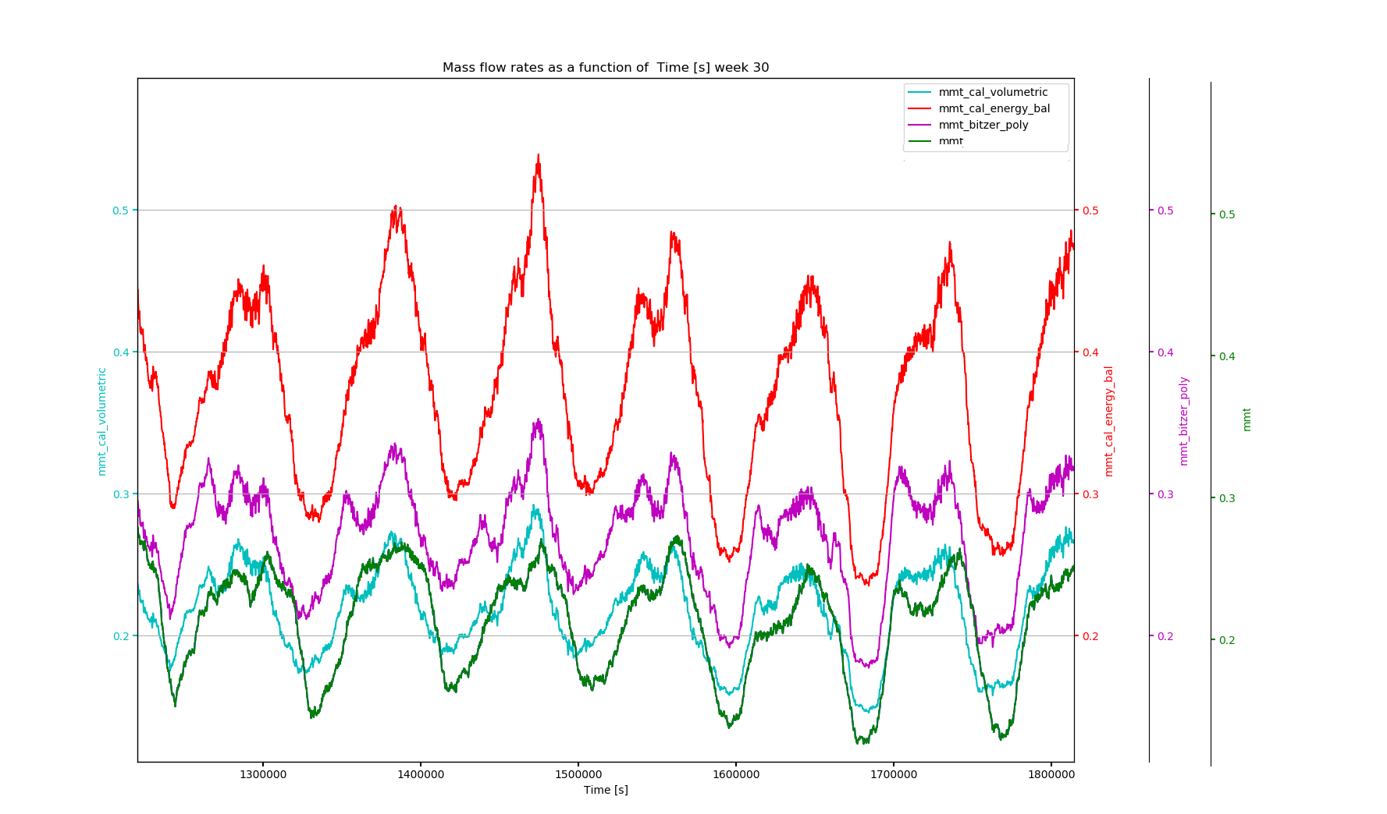
Mass flow rate estimation:
“ Why Data-Driven Modelling?”
Mass flow meter on LT evaporator (M4) wrong measurements for week 35
Mass flow in suction side of ejectors is not measured (Lack of data on ejector ports)
Mass flow on MT evaporator is not matching well with mass flow estimation with 3 aforementioned methods.
It was expected that analytical estimations for IT will have high error as for MT so it is suggested to use same data driven model trained based on MT for IT compressors mass flow rate estimation.
Time refrence for datetime conversion to seconds (t0) for all graphs is ”17:00:00 11/07/2019” (datetime format: " %H:%M:%S %d/%m/%Y”), 60 min moving average.

Slide 7
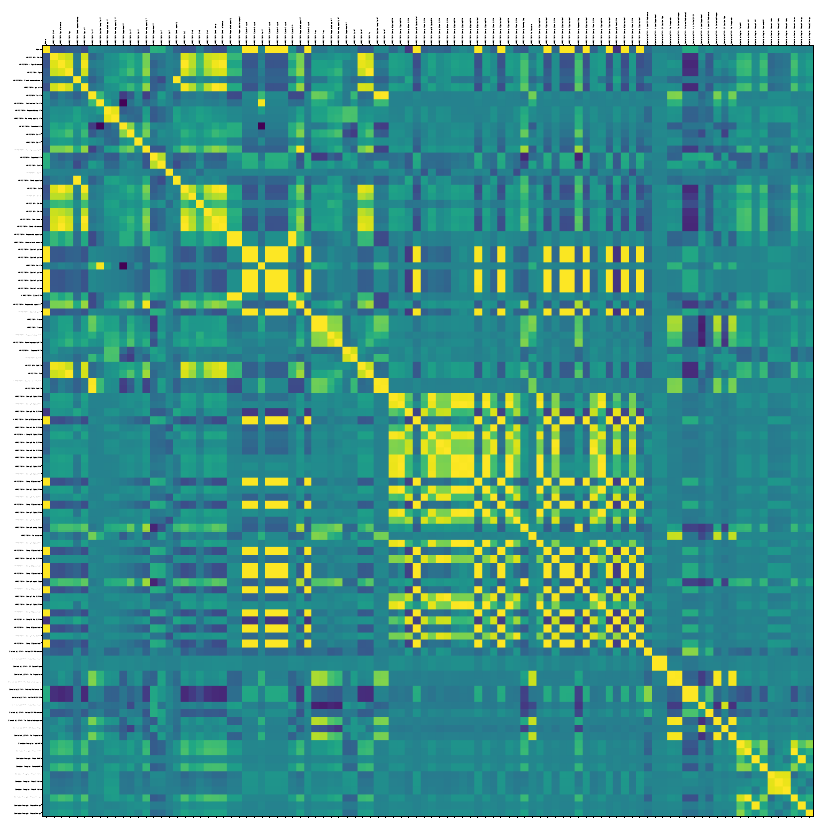
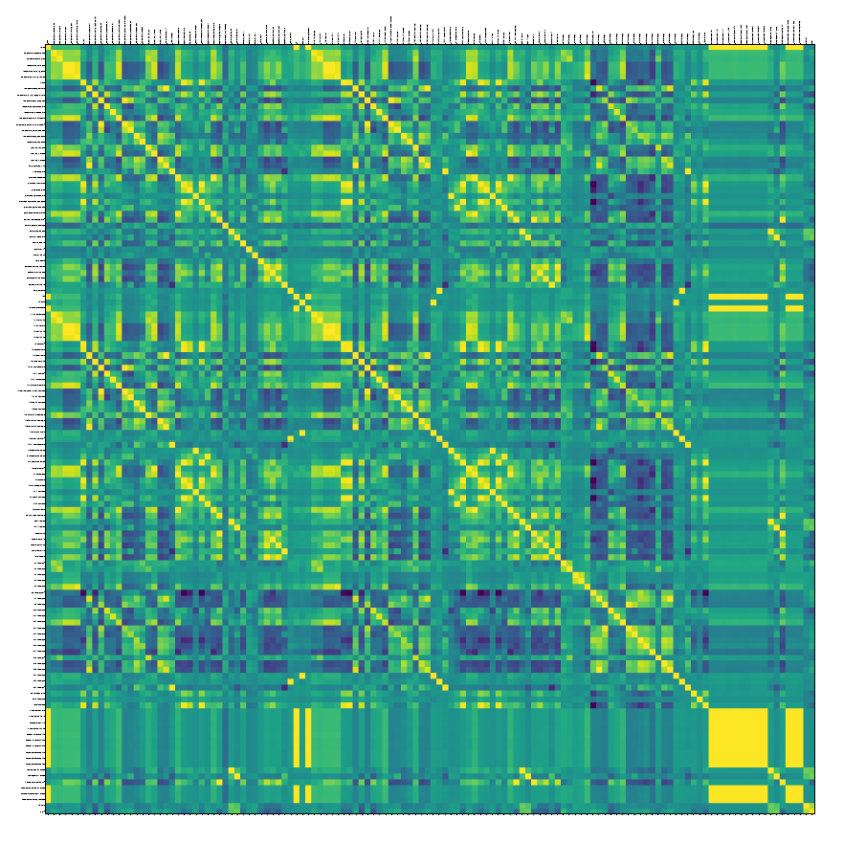
Data-Driven modeling: (Part 1)
Week 28 correlation map plot
Data cleaning
Finding correlation between each pair of data(Yellow indicates highly correlated data)
Removing highly correlated data(duplicates or unit converted)
Selection of weeks for training and weeks for test(Dividing data)
Model selection(Multivariable linear regression used here)
Danfoss
CNR

Slide 8
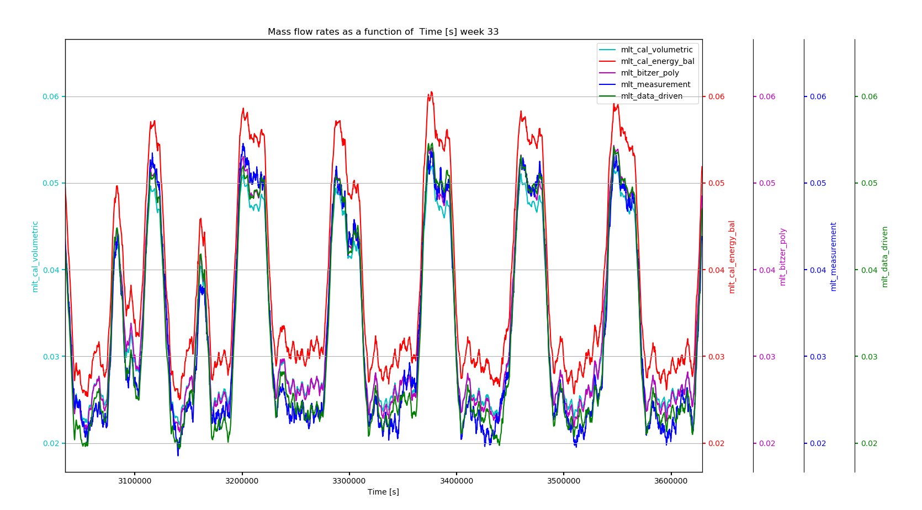
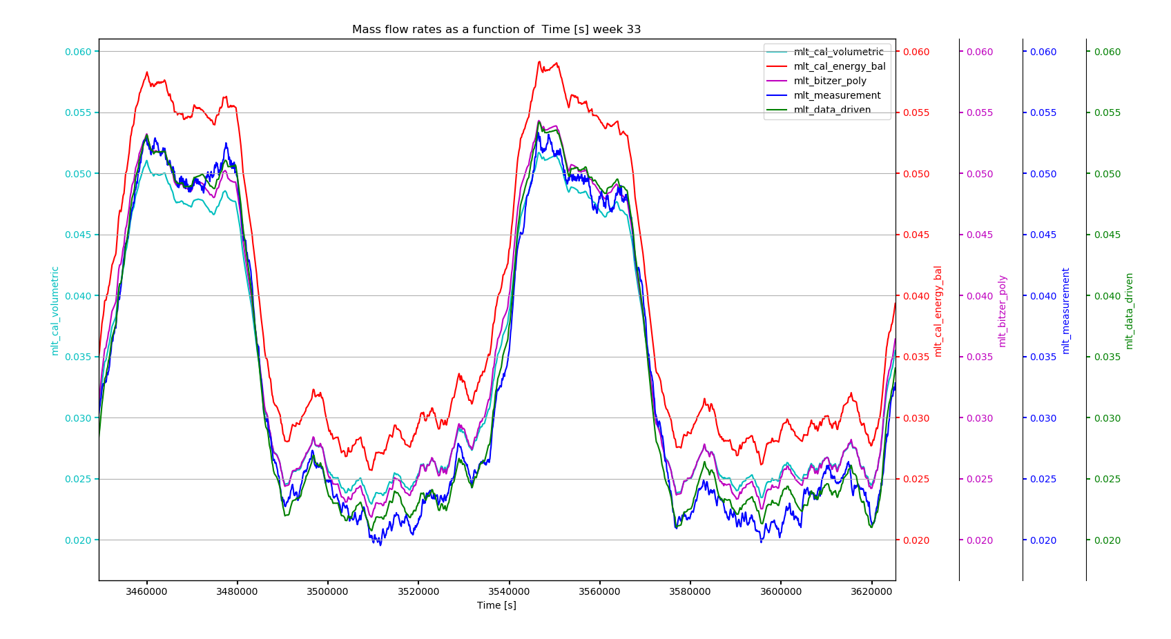
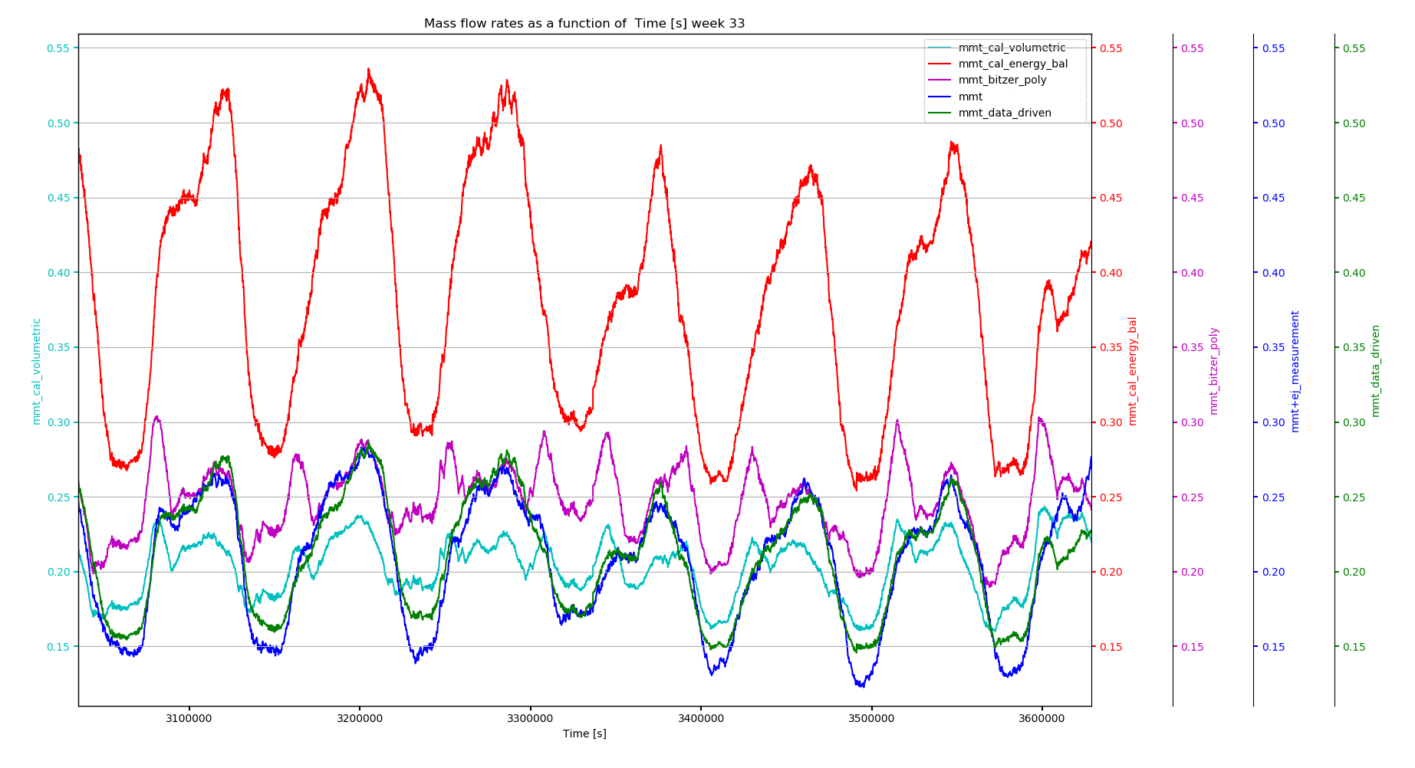
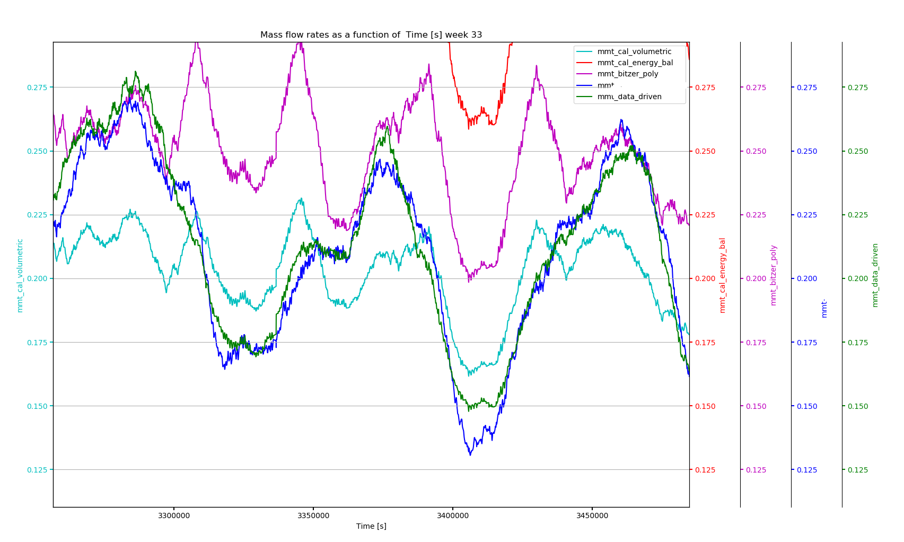
Data-Driven modeling: (Part 2)
For LT compressors, weeks 2-30 used for training, 31-34 for testing and 35 is estimated by model.
For MT compressors weeks 2-8 and 30 used for training(MT mass flow = M3+M4) and week 33 used for test and applied to weeks with Liquid &/ HP ejector.
Selecting parameters from data relevant for training
Automated process of selecting and removing variable to achieve least R2_score with user supervision to verify
Addition of analytical estimations of mass flow rate for improving the model
Data-Driven model is tested with new set of data it never seen before(Testing)
Zoom in
Zoom in
R2_score LT W33 MT W33
VD vs measurement : 0.939 -1.060
EB vs measurement : 0.696 -4.176
BT vs measurement 0.958 -3.480
DD vs measurement : 0.981 0.8904
Time refrence for datetime conversion to seconds (t0) for all graphs is ”17:00:00 11/07/2019” (datetime format: " %H:%M:%S %d/%m/%Y”), 120 min moving average.

Slide 9
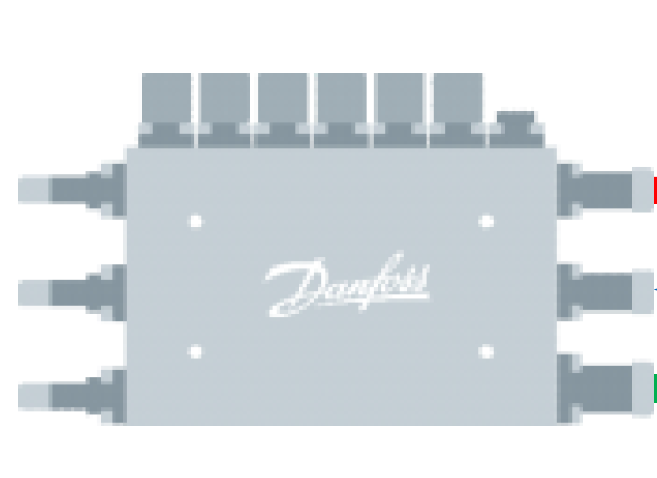
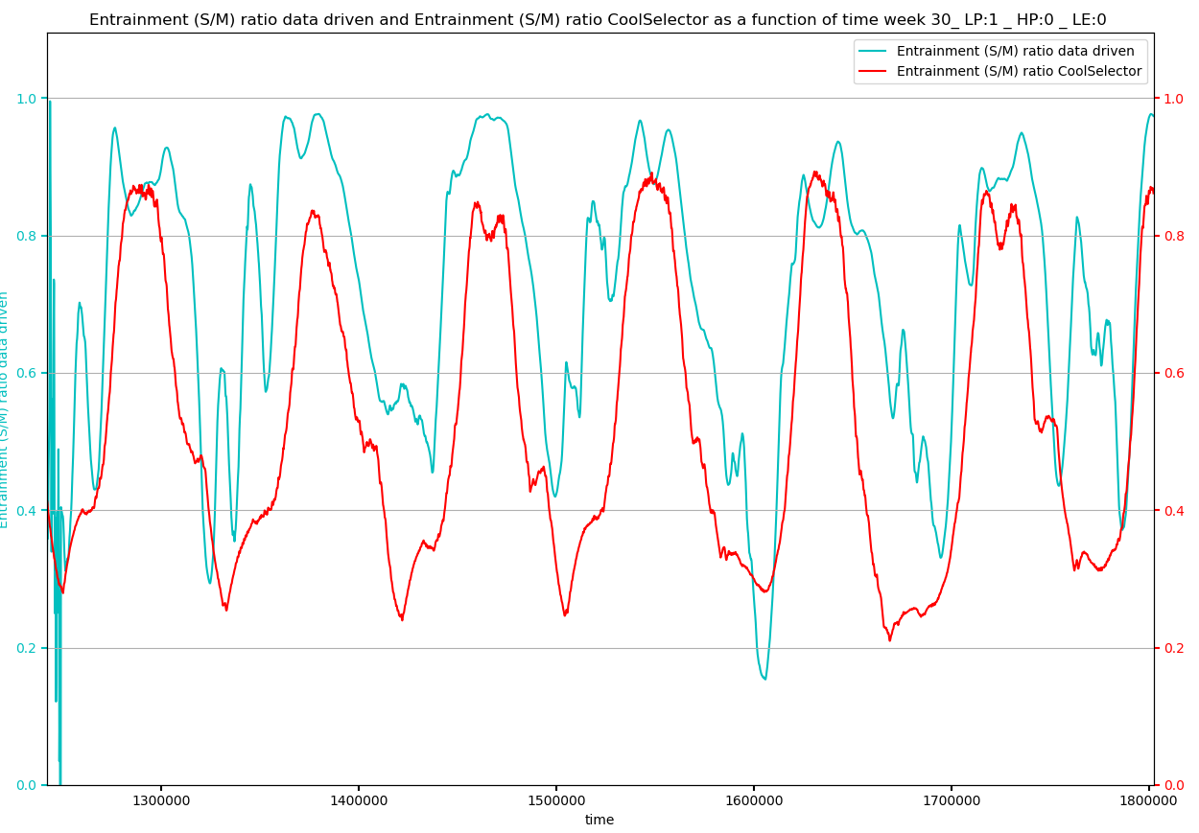
Week 30(LP Ejector only):
Motive
Motive nozzle mass flow rate :
MT+ IT – HPV
Suction side mass flow rate:
M1
Discharge mass flow rate:
MT + IT + M1 - HPV
Suction
Discharge
MT : Mass flow rate through MT compressors (Kg/s)
IT : Mass flow rate through IT compressors (Kg/s)
HPV : Mass flow rate through high pressure valve (Kg/s)
M1: Mass flow rate through AC evaporators (Kg/s)
Time refrence for datetime conversion to seconds (t0) for all graphs is ”17:00:00 11/07/2019” (datetime format: " %H:%M:%S %d/%m/%Y”), 180 min moving average.

Slide 10
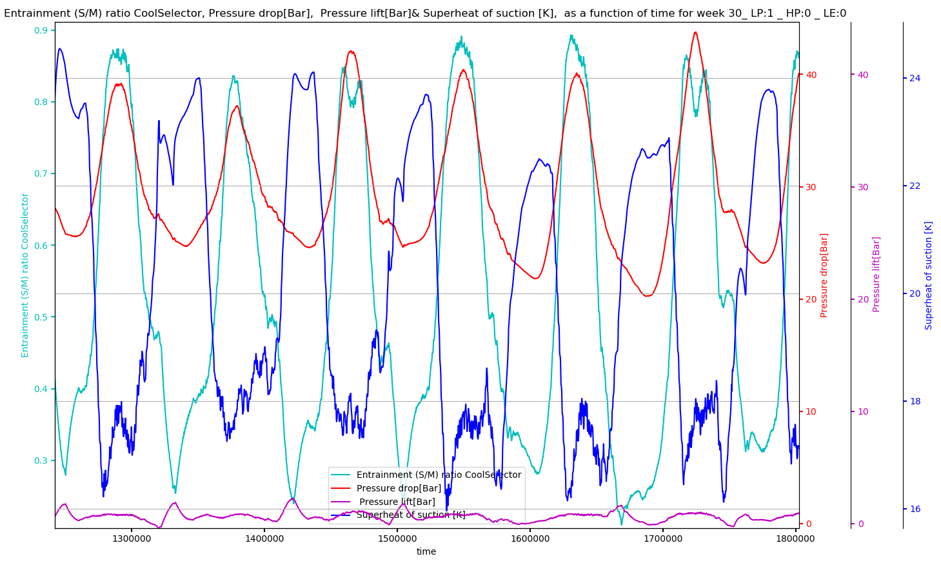
Week 30(LP Ejector only):
Motive
Suction
Motive nozzle mass flow rate :
MT + IT - HPV
Suction side mass flow rate:
M1
Discharge mass flow rate:
MT + IT + M1 - HPV
Discharge
Time refrence for datetime conversion to seconds (t0) for all graphs is ”17:00:00 11/07/2019” (datetime format: " %H:%M:%S %d/%m/%Y”), 180 min moving average.

Slide 11

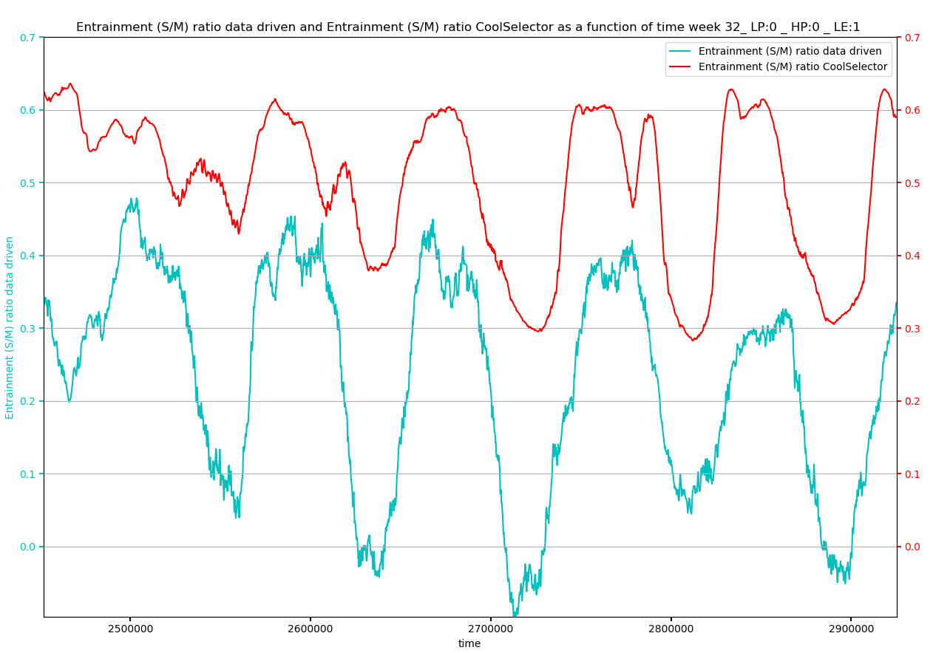
Week 32(Liquid Ejector only):
Motive
Motive nozzle mass flow rate :
MT+ IT - M5 - HPV
Suction side mass flow rate:
M3 + M4 - MT
Discharge mass flow rate:
M3 + M4 + IT - M5 - HPV
Suction
Discharge
MT : Mass flow rate through MT compressors (Kg/s)
IT : Mass flow rate through IT compressors (Kg/s)
M3: Mass flow rate through MT evaporators (Kg/s)
HPV : Mass flow rate through high pressure valve (Kg/s)
M5: Mass flow rate through AC evaporators (Kg/s)
M4: Mass flow rate through LT evaporators (Kg/s)
Time refrence for datetime conversion to seconds (t0) for all graphs is ”17:00:00 11/07/2019” (datetime format: " %H:%M:%S %d/%m/%Y”), 180 min moving average.

Slide 12
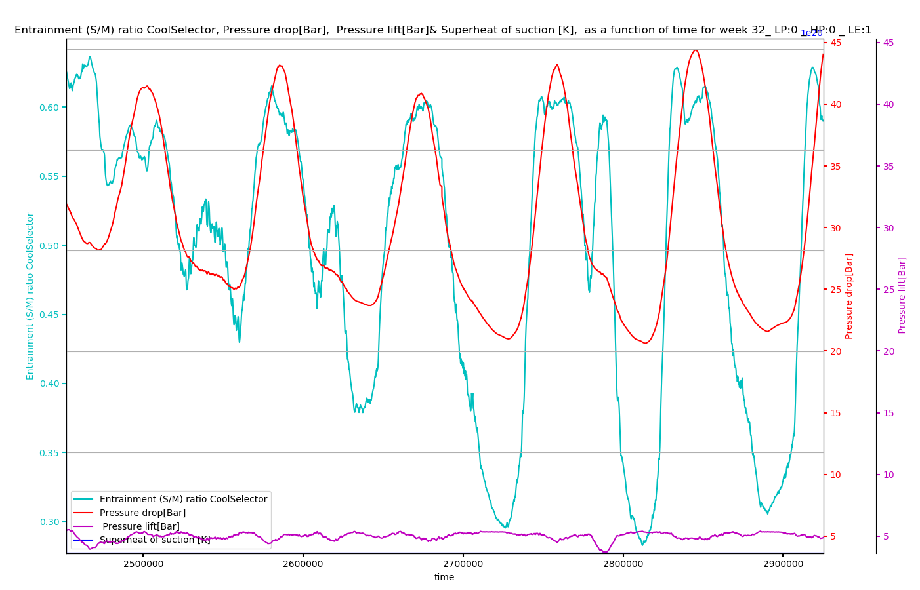
Week 32(Liquid Ejector only):
Motive
Suction
Discharge
Motive nozzle mass flow rate :
MT+ IT - M5 - HPV
Suction side mass flow rate:
M3 + M4 - MT
Discharge mass flow rate:
M3 + M4 + IT - M5 – HPV
Time refrence for datetime conversion to seconds (t0) for all graphs is ”17:00:00 11/07/2019” (datetime format: " %H:%M:%S %d/%m/%Y”), 180 min moving average.

Slide 13
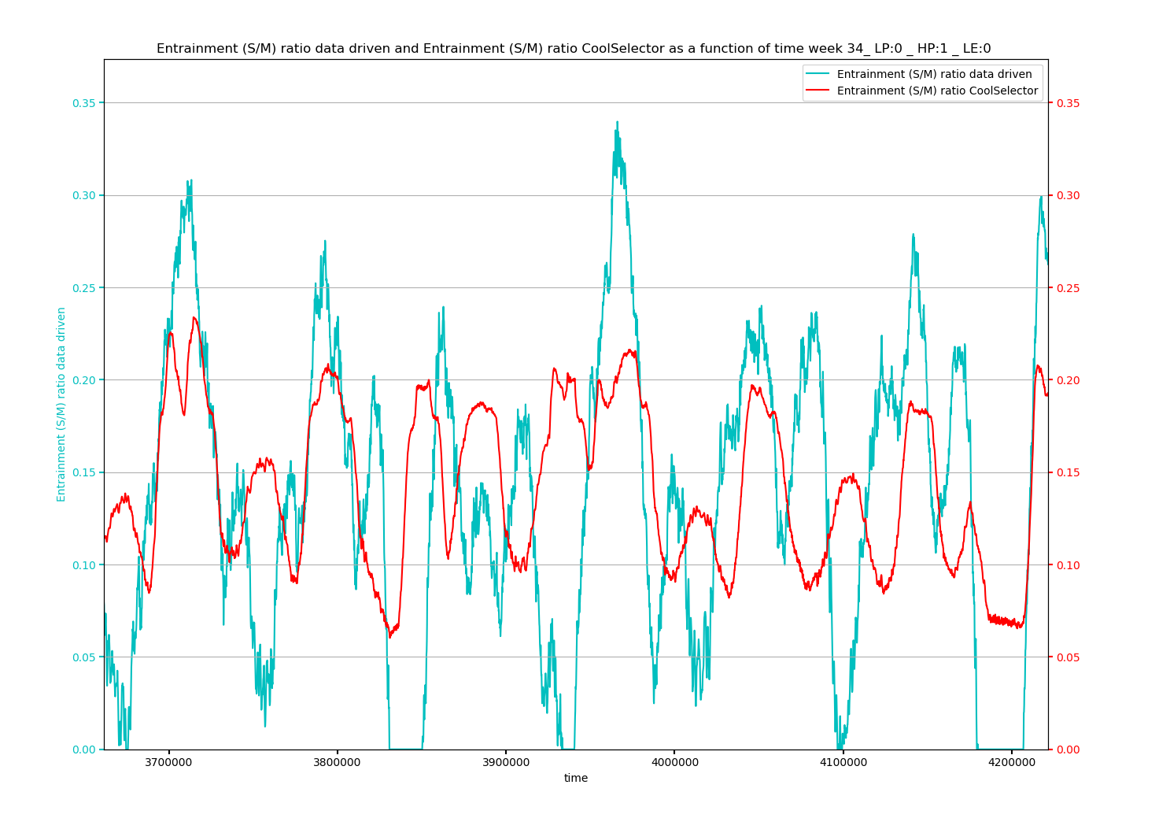
Week 34(HP Ejector only):
Motive
Motive nozzle mass flow rate :
MT + IT –M5
Suction side mass flow rate:
M3 + M4 -MT
Discharge mass flow rate:
M3 + M4 + IT - M5
Suction
Discharge
MT : Mass flow rate through MT compressors (Kg/s)
IT : Mass flow rate through IT compressors (Kg/s)
M3: Mass flow rate through MT evaporators (Kg/s)
HPV : Mass flow rate through high pressure valve (Kg/s)
M5: Mass flow rate through AC evaporators (Kg/s)
M4: Mass flow rate through LT evaporators (Kg/s)
Time refrence for datetime conversion to seconds (t0) for all graphs is ”17:00:00 11/07/2019” (datetime format: " %H:%M:%S %d/%m/%Y”), 180 min moving average.

Slide 14
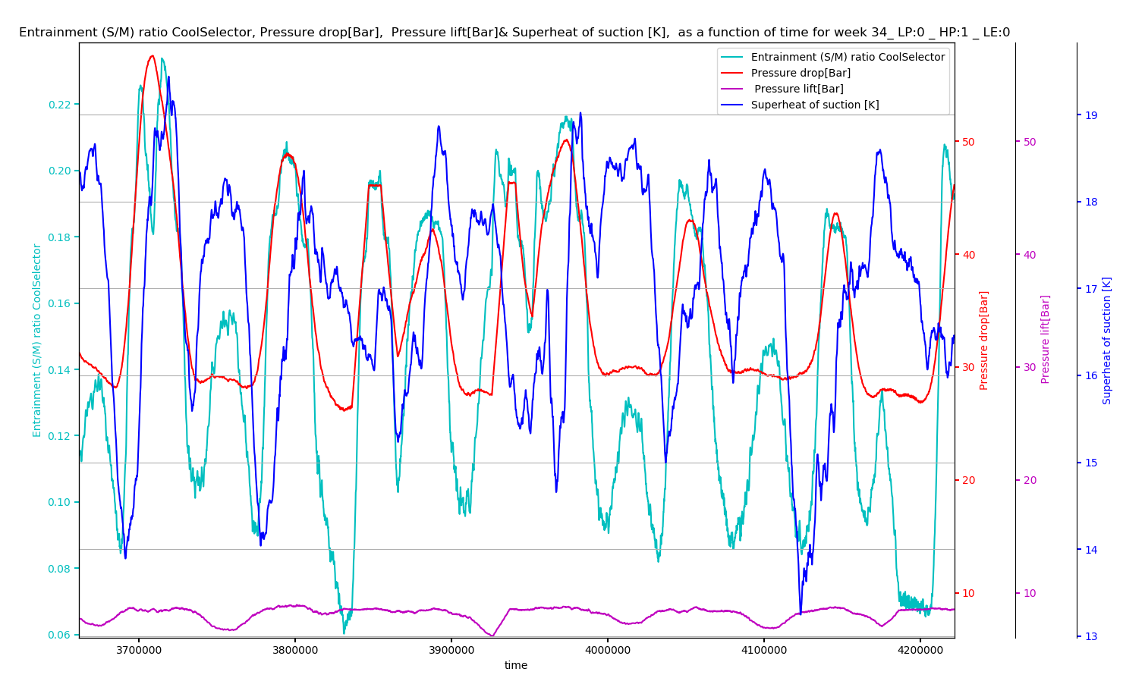
Week 34(HP Ejector only):
Motive
Suction
Motive nozzle mass flow rate :
MT + IT –M5
Suction side mass flow rate:
M3 + M4 -MT
Discharge mass flow rate:
M3 + M4 + IT - M5
Discharge
Time refrence for datetime conversion to seconds (t0) for all graphs is ”17:00:00 11/07/2019” (datetime format: " %H:%M:%S %d/%m/%Y”), 180 min moving average.

Slide 15
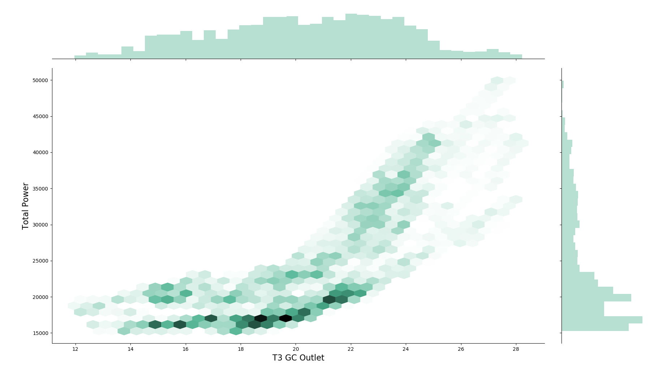
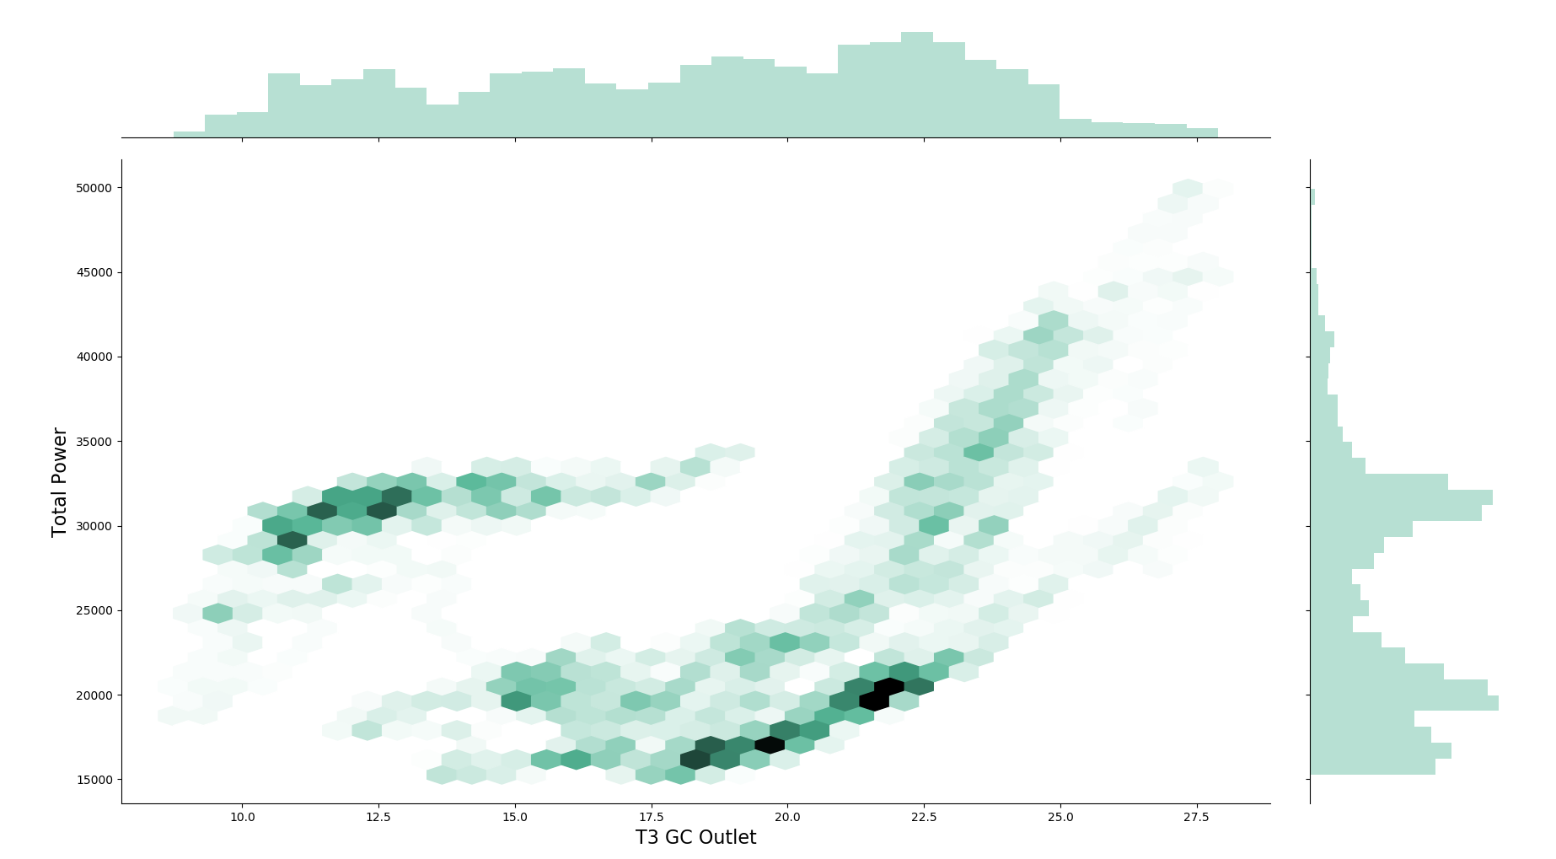
Total power input of compressors Vs. Gas cooler outlet:
Weeks 9 to 35
Weeks 2 to 35
Weeks 2- 9 indicate period with no ejector installed
Summer
Winter
High power consumption for weeks without ejector??? Or other reasons?
Later informed a control issue running gas cooler at full power

Slide 16
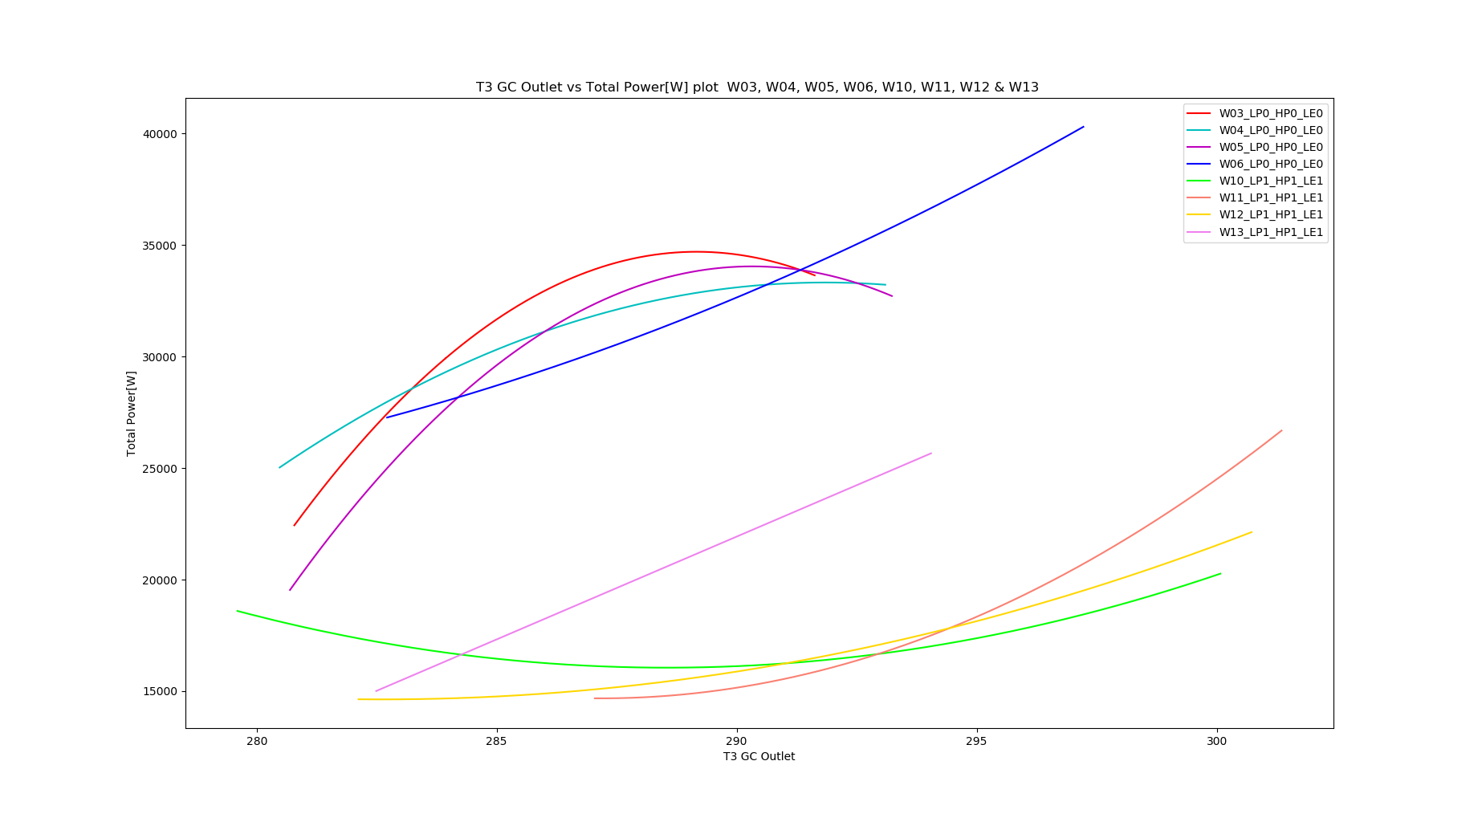
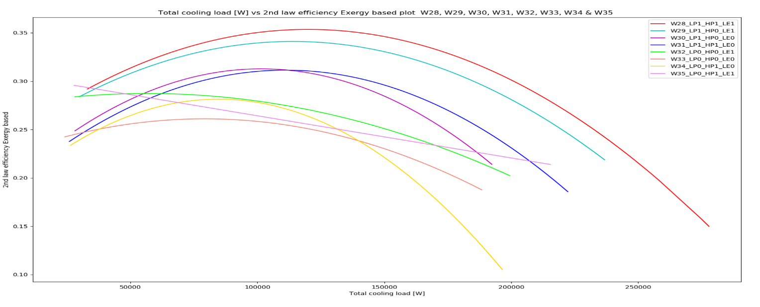
Total power input of compressors Vs. Gas cooler outlet:
Weeks 3,4,5 & 6 (no ejector)
compared with
Weeks 10,11,12 & 13(with HP, LP and Liq. ejector)
High power consumption for weeks without ejector

Slide 17
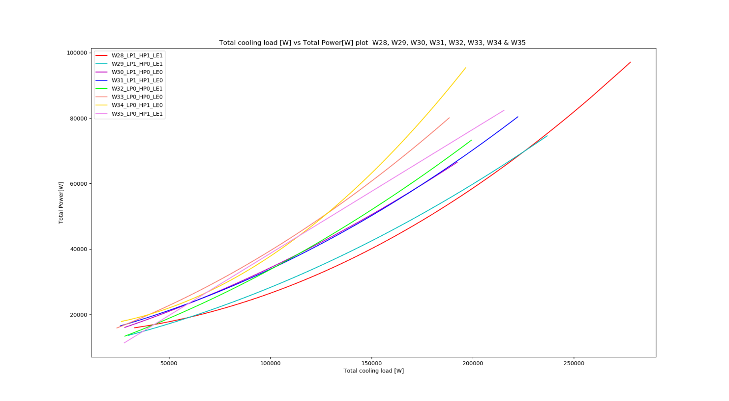
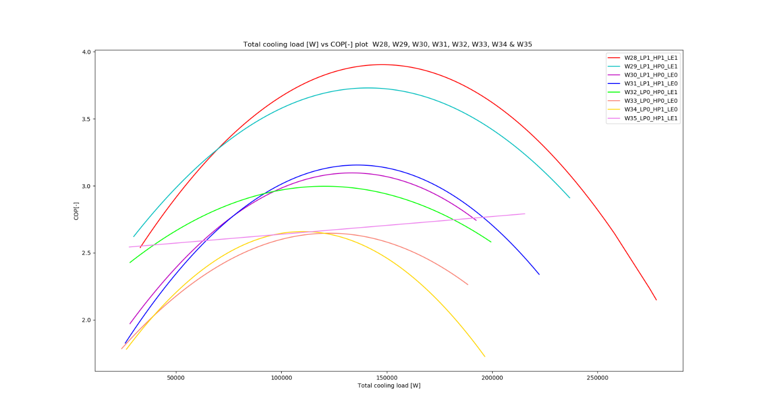
2nd law efficiency and total power consumption Vs. Cooling load:
Weeks 28 to 35 compared:
0 indicating ejector off
1 indicating ejector running
Weekly modes:
'_ LP:1 _ HP:1 _ LE:1 ', # W28 '_ LP:1 _ HP:0 _ LE:1 ', # W29 '_ LP:1 _ HP:0 _ LE:0 ', # W30 LP only '_ LP:1 _ HP:1 _ LE:0 ', # W31 '_ LP:0 _ HP:0 _ LE:1 ', # W32 LE only '_ LP:0 _ HP:0 _ LE:0 ', # W33 '_ LP:0 _ HP:1 _ LE:0 ', # W34 HP only '_ LP:0 _ HP:1 _ LE:1 ' # W35

Slide 18
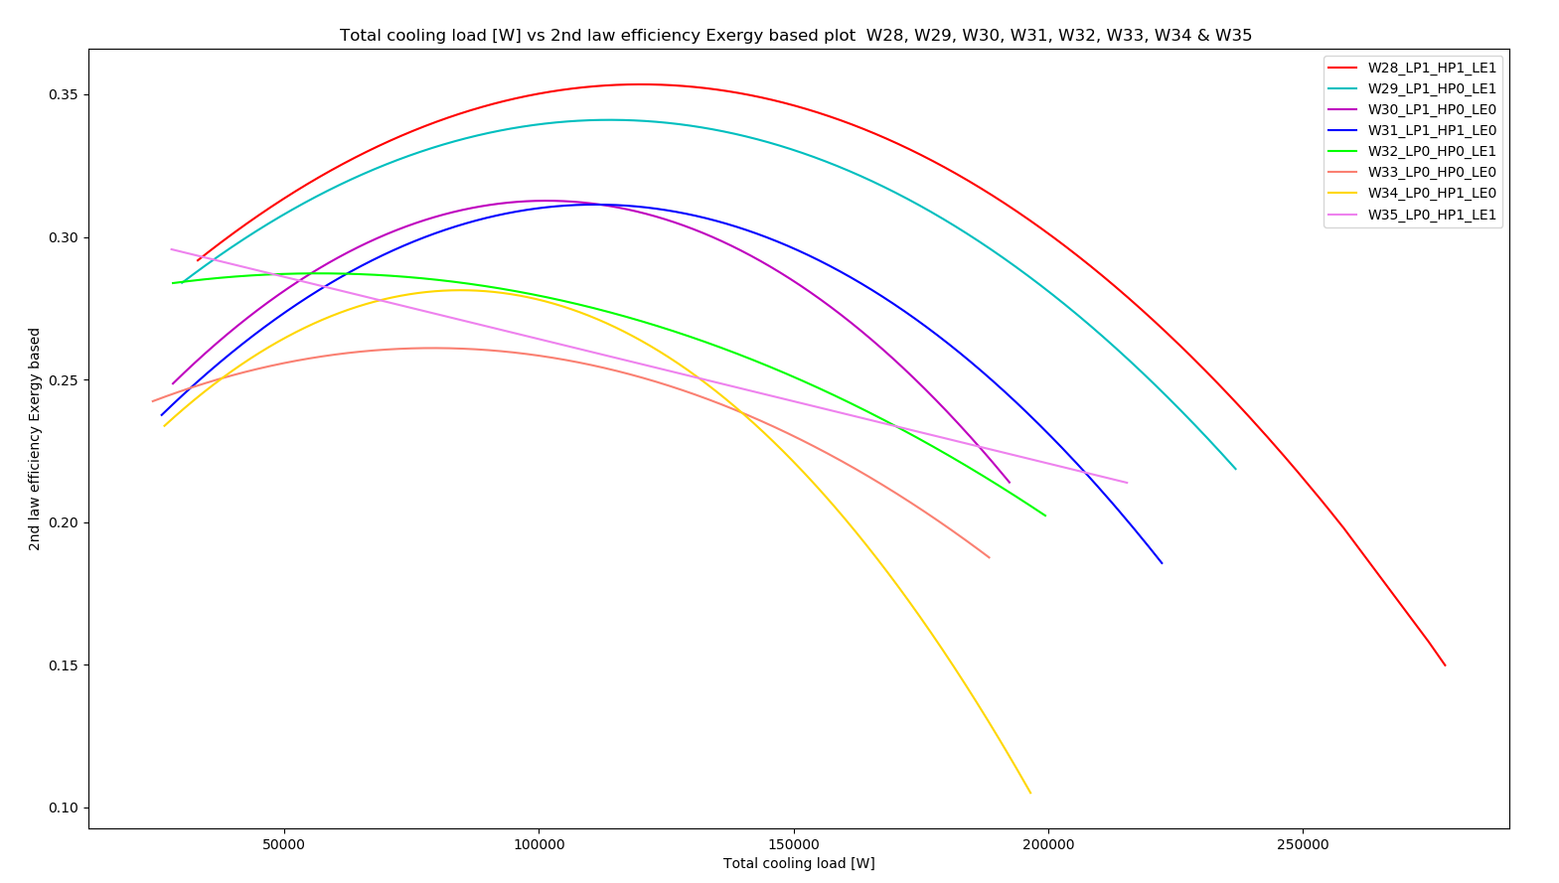
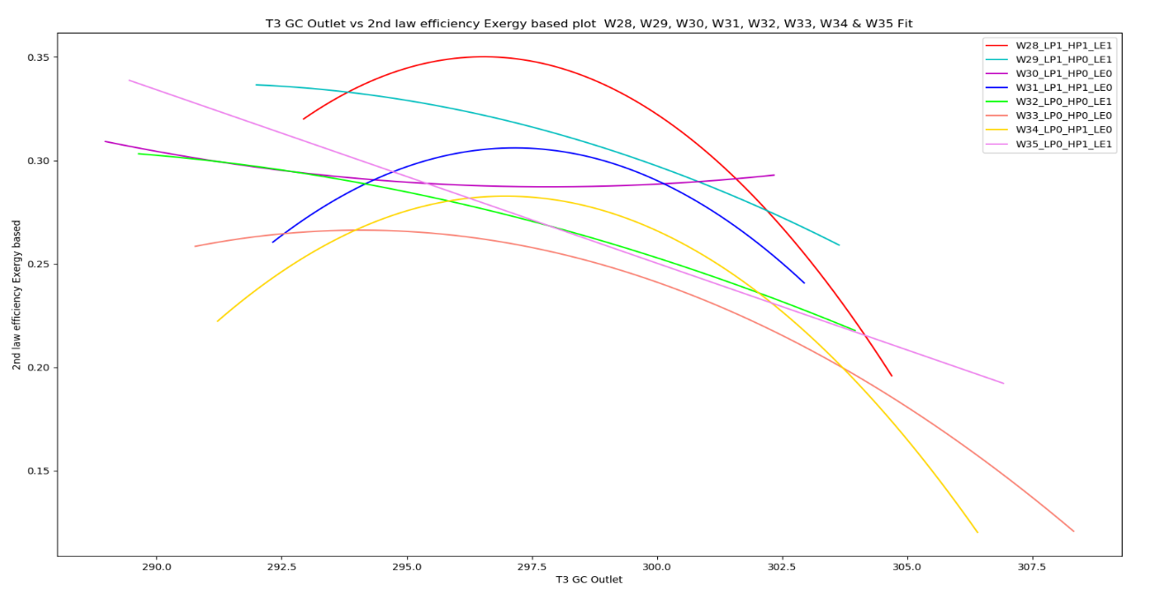
2nd law efficiency Vs. Cooling load:
Weeks 28 to 35 compared:
0 indicating ejector off
1 indicating ejector running
Weekly modes:
'_ LP:1 _ HP:1 _ LE:1 ', # W28 '_ LP:1 _ HP:0 _ LE:1 ', # W29 '_ LP:1 _ HP:0 _ LE:0 ', # W30 LP only '_ LP:1 _ HP:1 _ LE:0 ', # W31 '_ LP:0 _ HP:0 _ LE:1 ', # W32 LE only '_ LP:0 _ HP:0 _ LE:0 ', # W33 '_ LP:0 _ HP:1 _ LE:0 ', # W34 HP only '_ LP:0 _ HP:1 _ LE:1 ' # W35

Slide 19
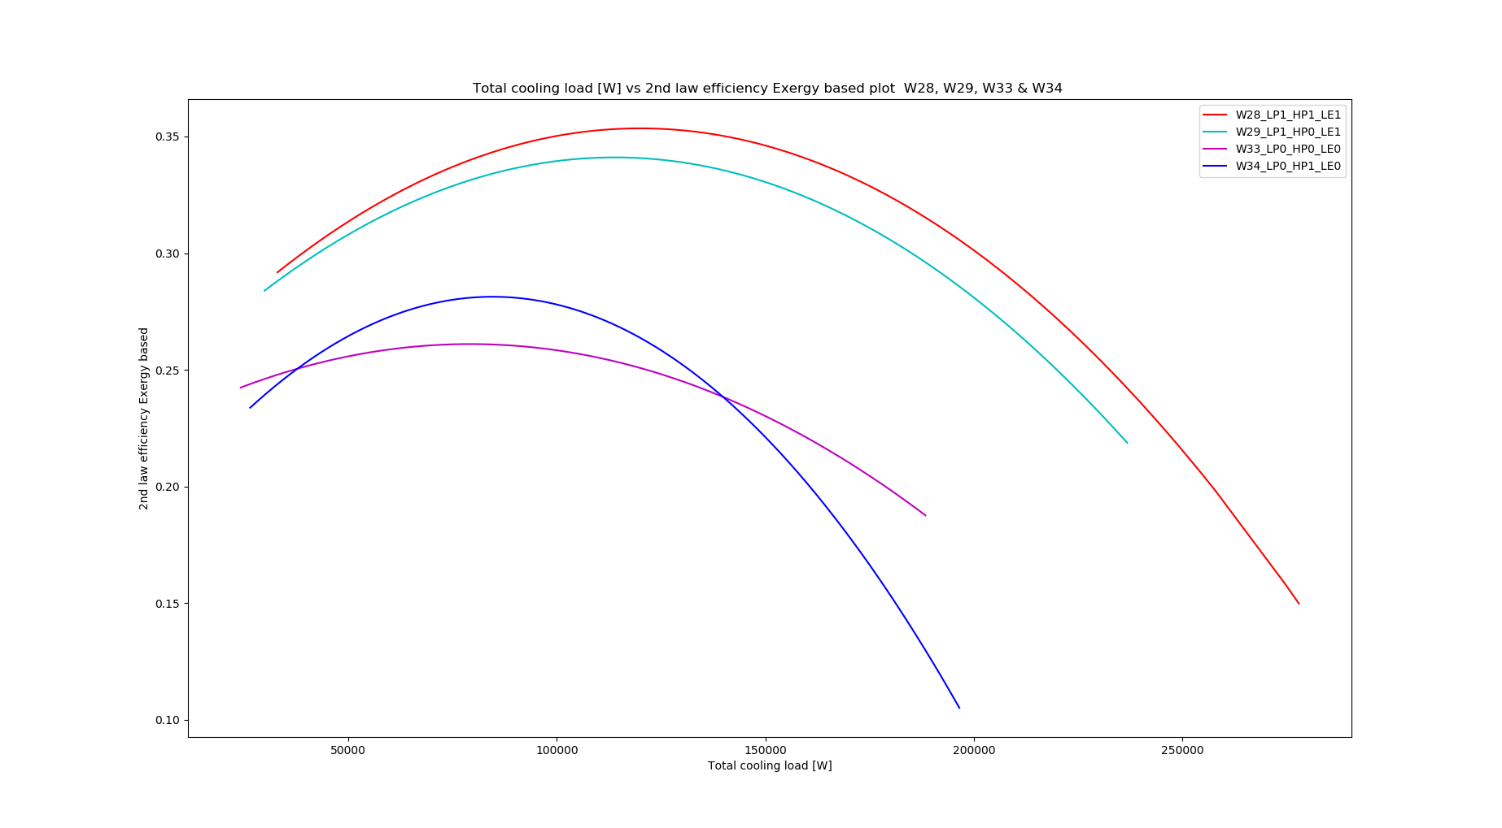
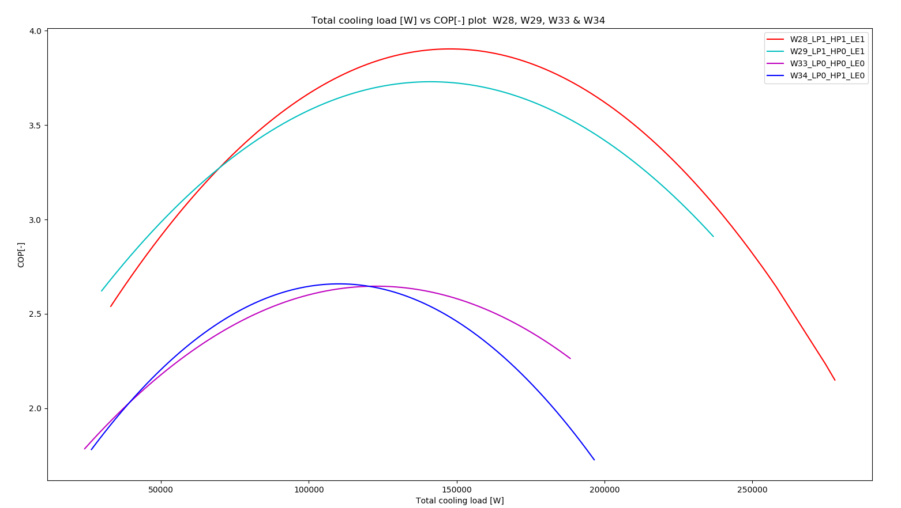
2nd law efficiency & COP Vs. Cooling load (HP ejector effect) :
Weeks plotted:
28 All ejectors
29 All except HP
34 Only HP
33 No ejectors

Slide 20
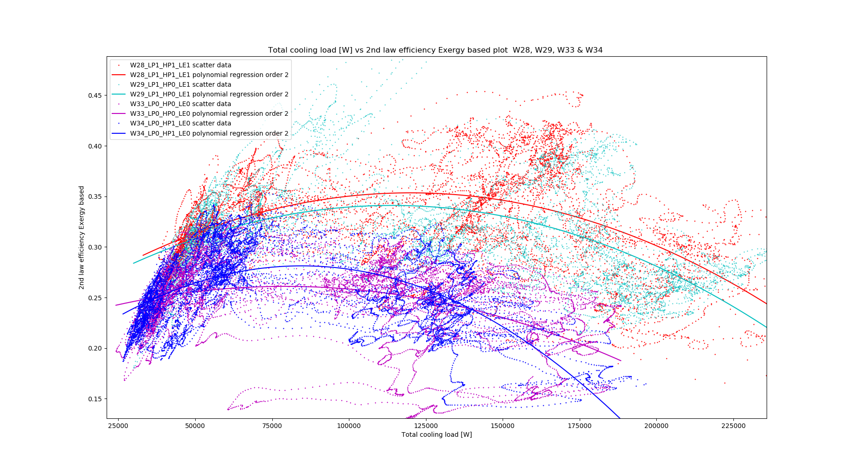
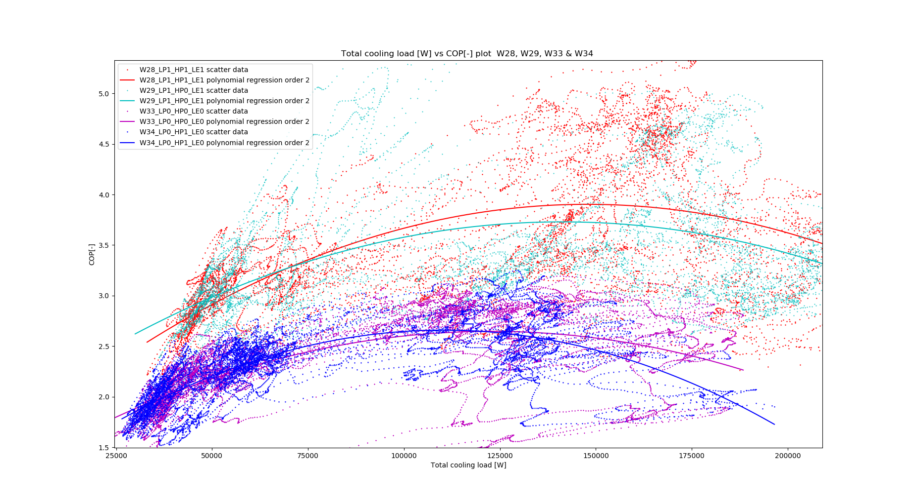
2nd law efficiency & COP Vs. Cooling load (HP ejector effect) :
Weeks plotted:
28 All ejectors
29 All except HP
34 Only HP
33 No ejectors
The reason data seem on a trail following one another is a mistake of applying moving average where there should not be

Slide 21
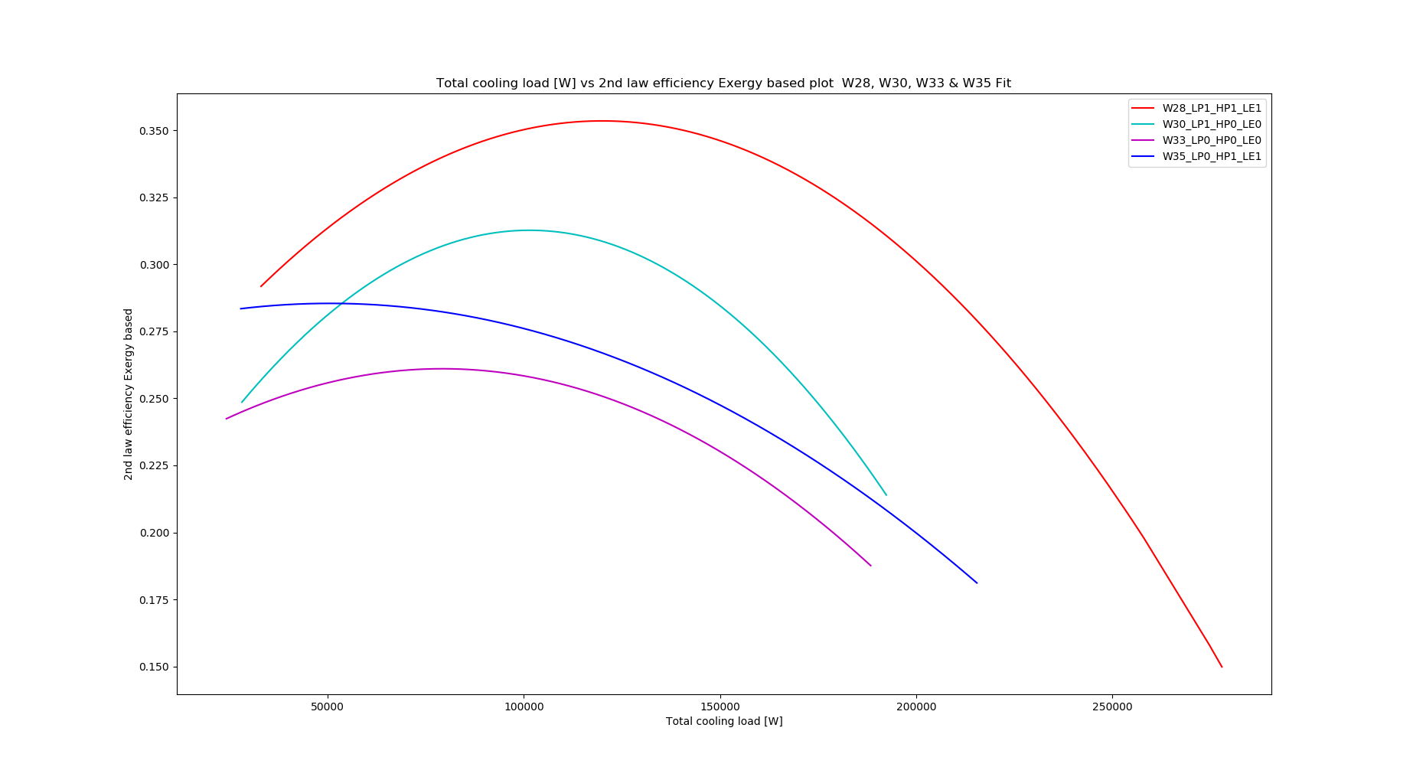
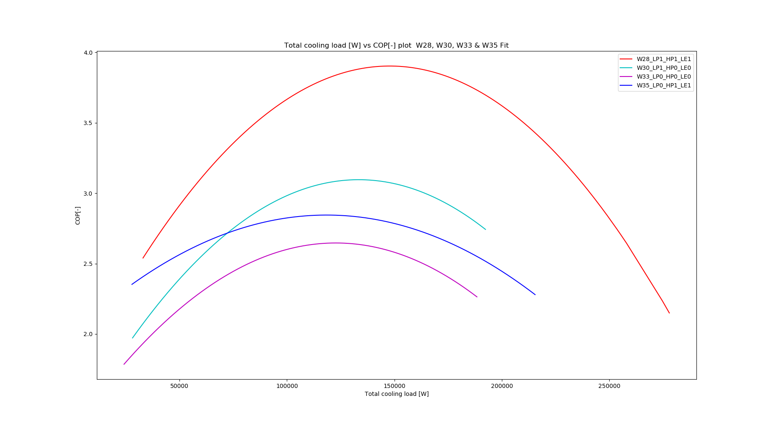
2nd law efficiency & COP Vs. Cooling load (LP ejector effect) :
Weeks plotted:
28 All ejectors
35 All except LP
30 LP only
33 No ejectors

Slide 22
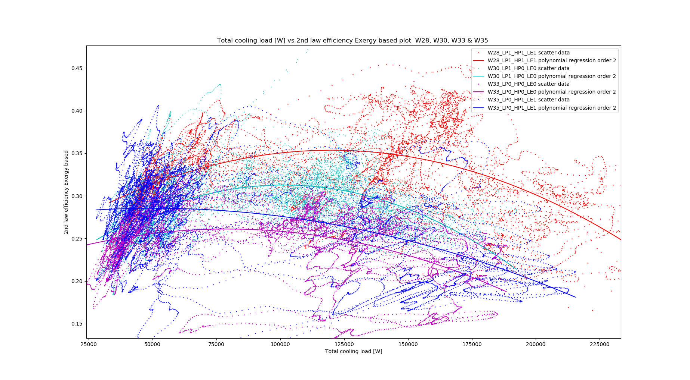
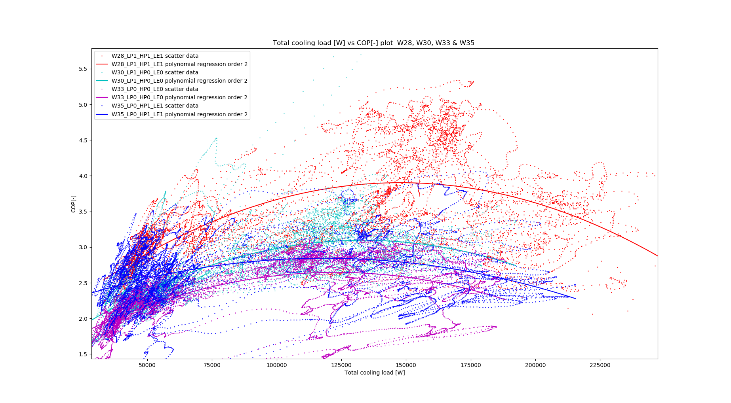
2nd law efficiency & COP Vs. Cooling load (LP ejector effect) :
Weeks plotted:
28 All ejectors
35 All except LP
30 LP only
33 No ejectors

Slide 23
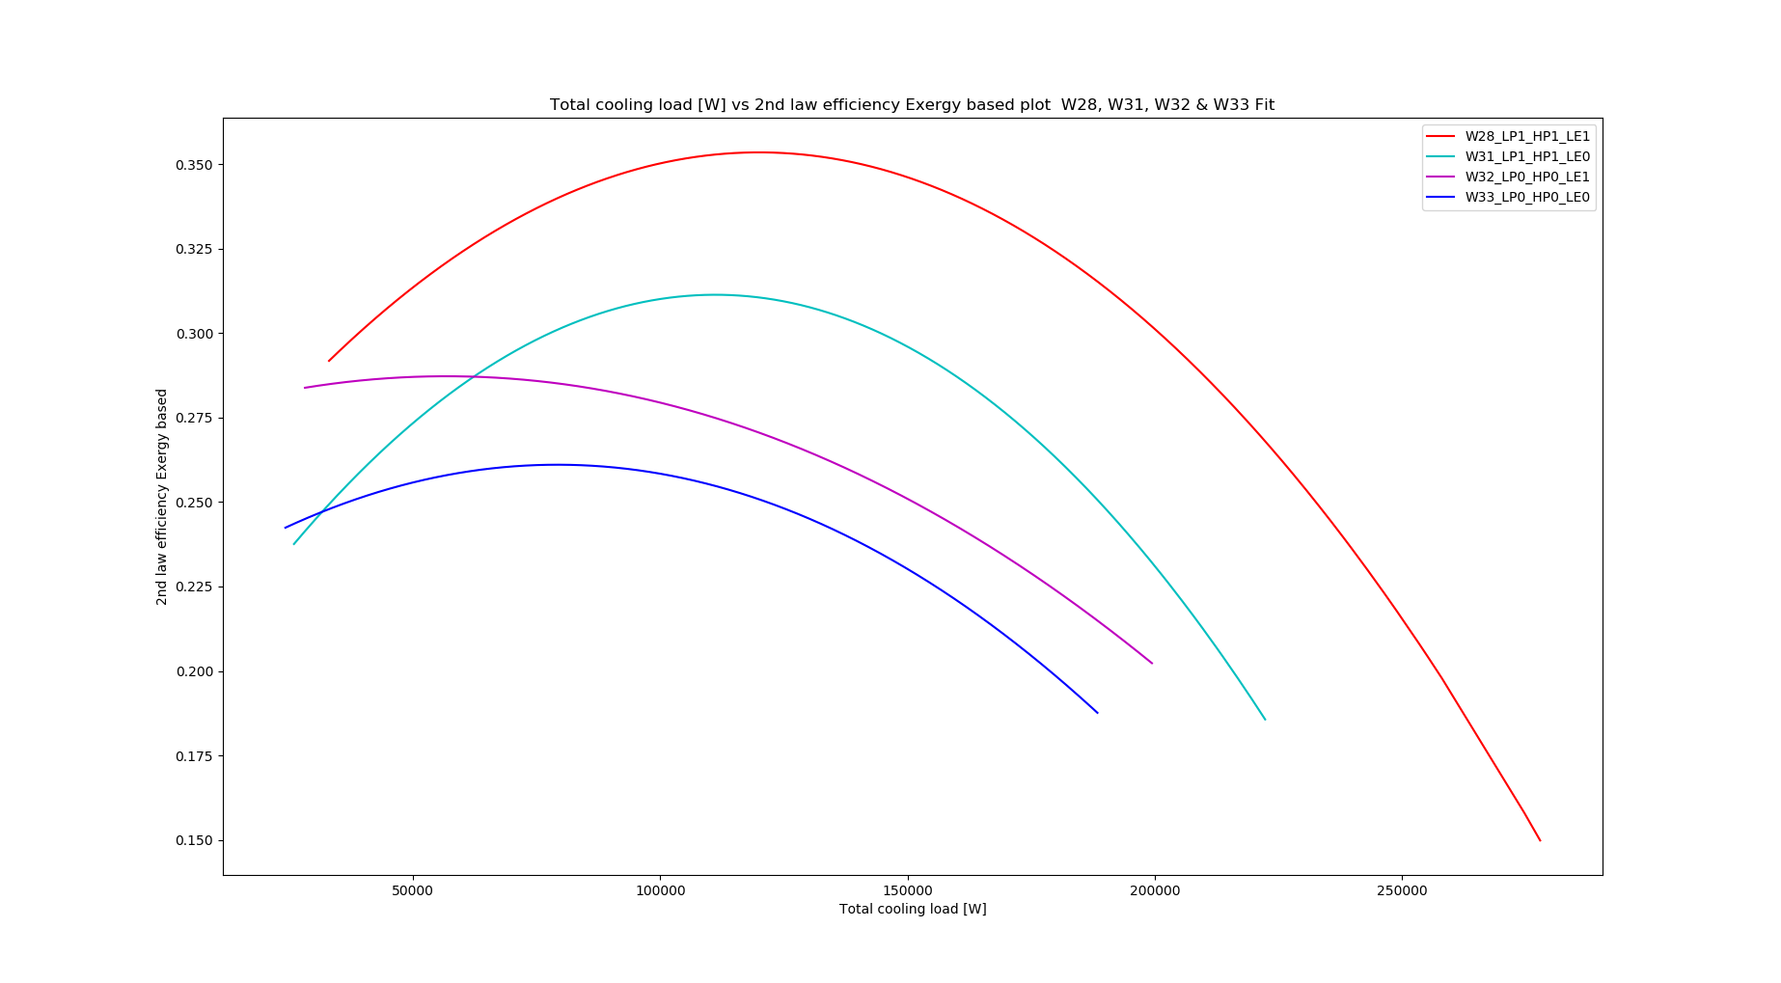
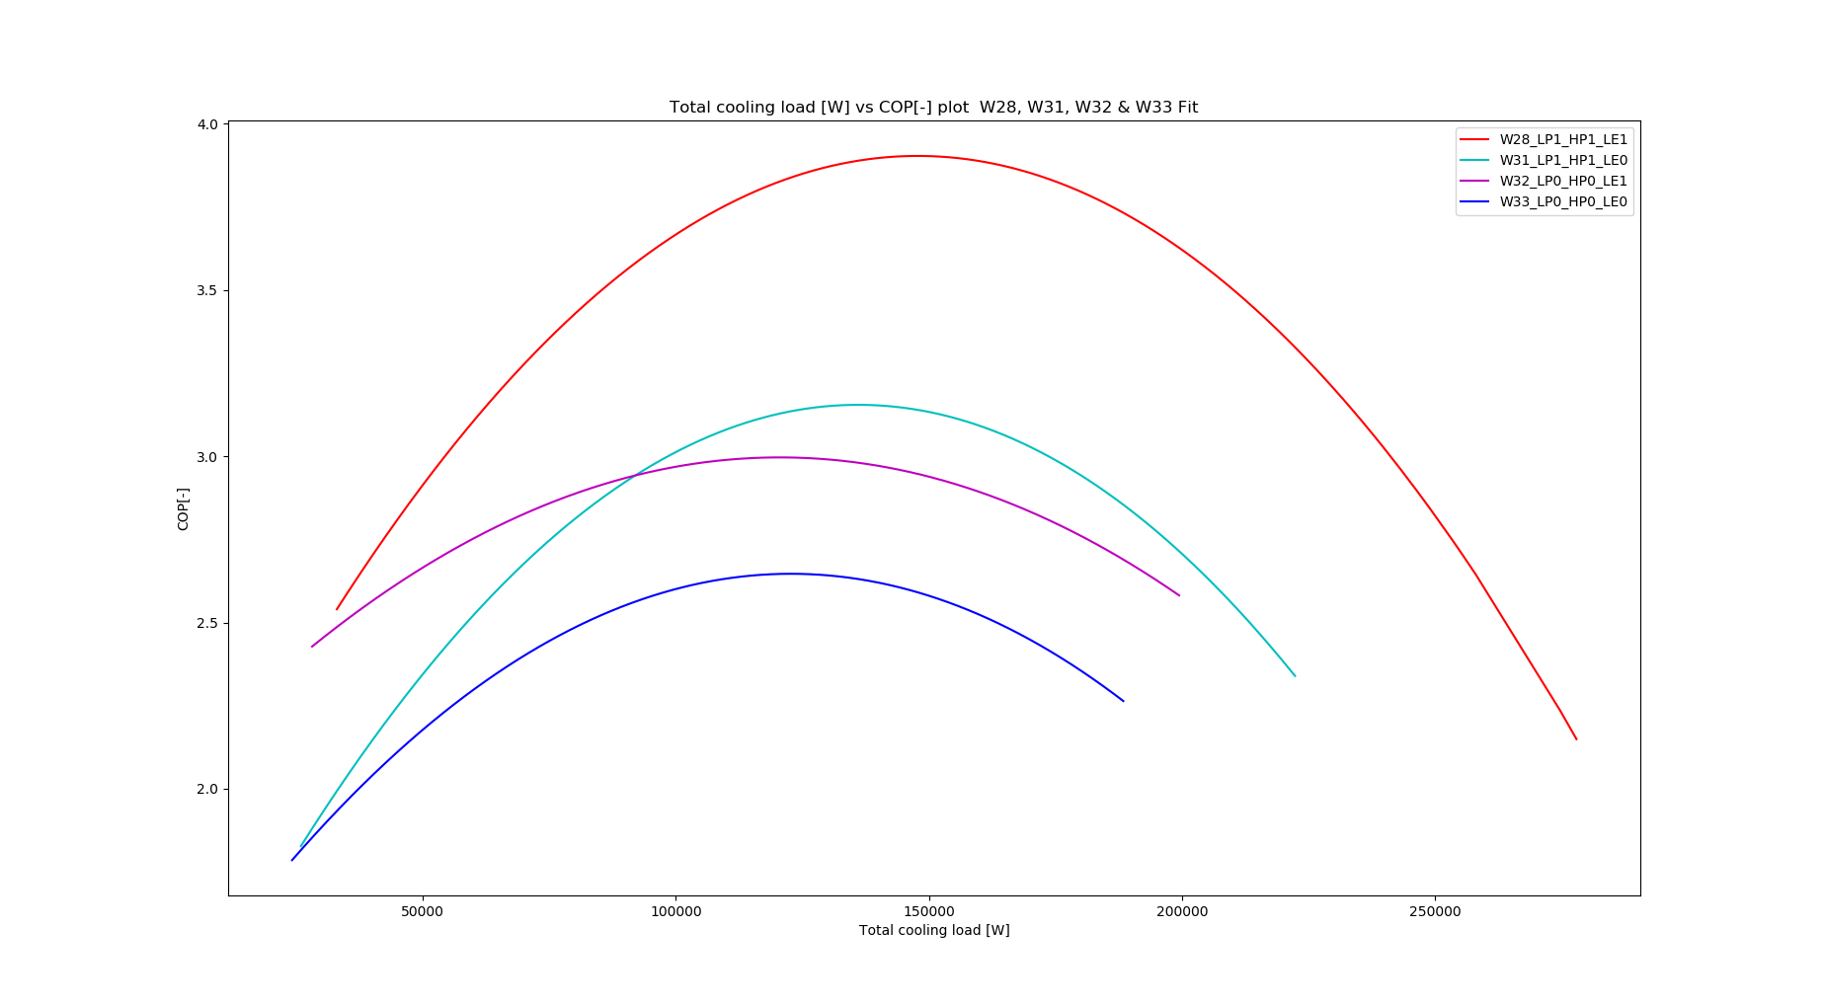
2nd law efficiency & COP Vs. Cooling load (Liq. ejector effect) :
Weeks plotted:
28 All ejectors
31 All except LE
32 LE Only
33 No ejectors

Slide 24
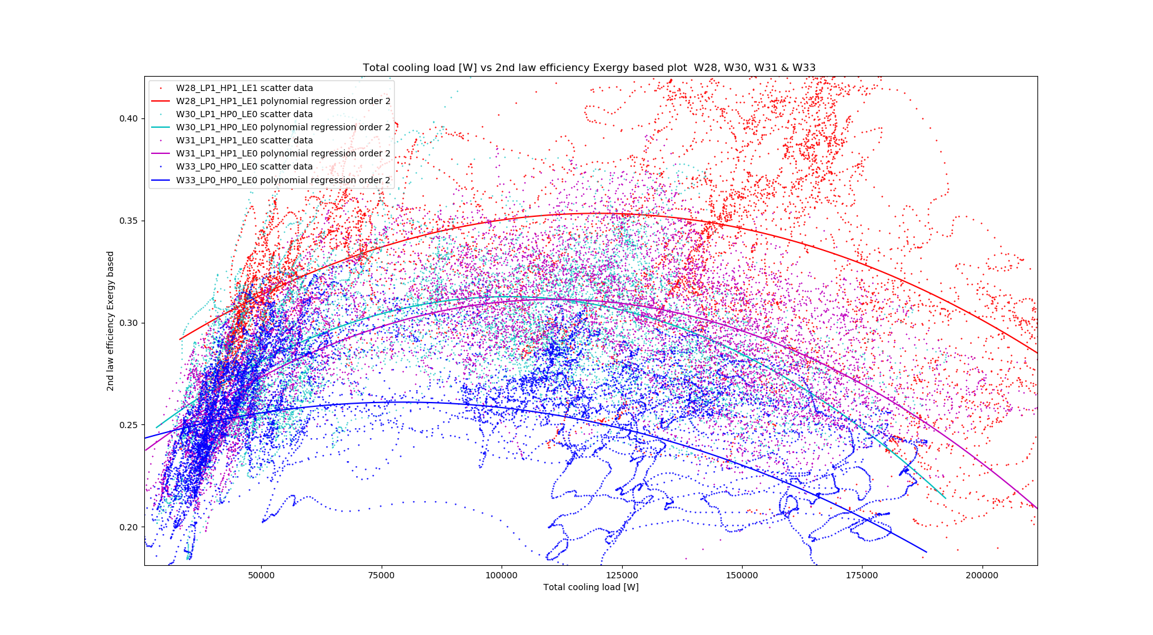
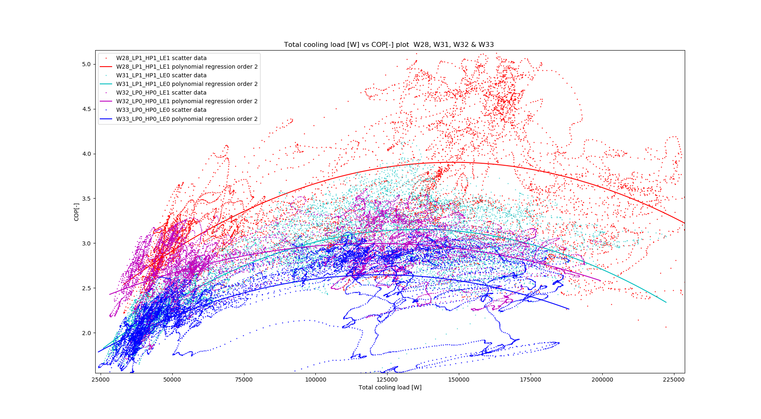
2nd law efficiency & COP Vs. Cooling load (Liq. ejector effect) :
Weeks plotted:
28 All ejectors
31 All except LE
32 LE Only
33 No ejectors

Slide 25
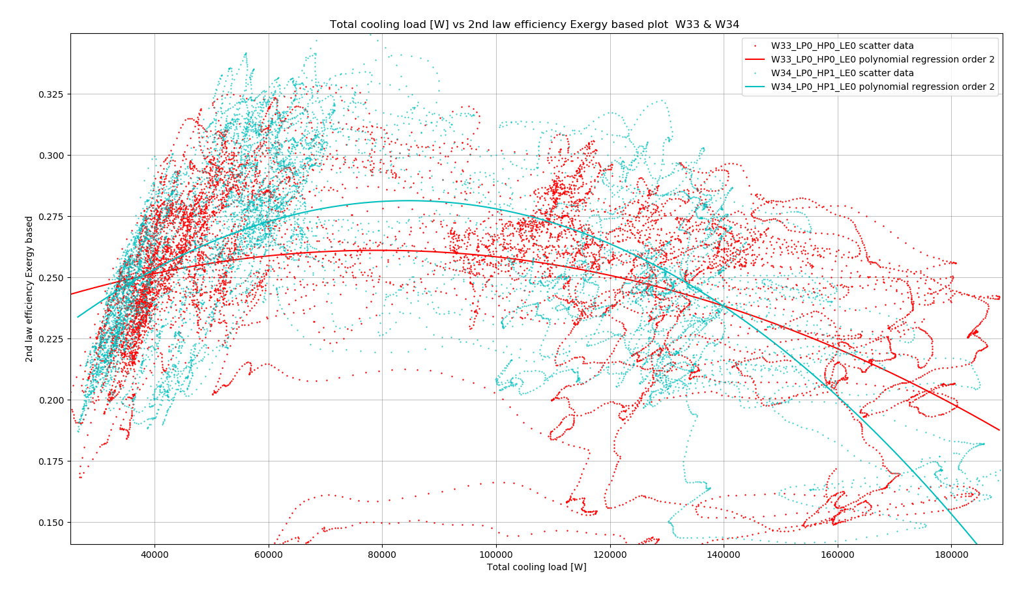
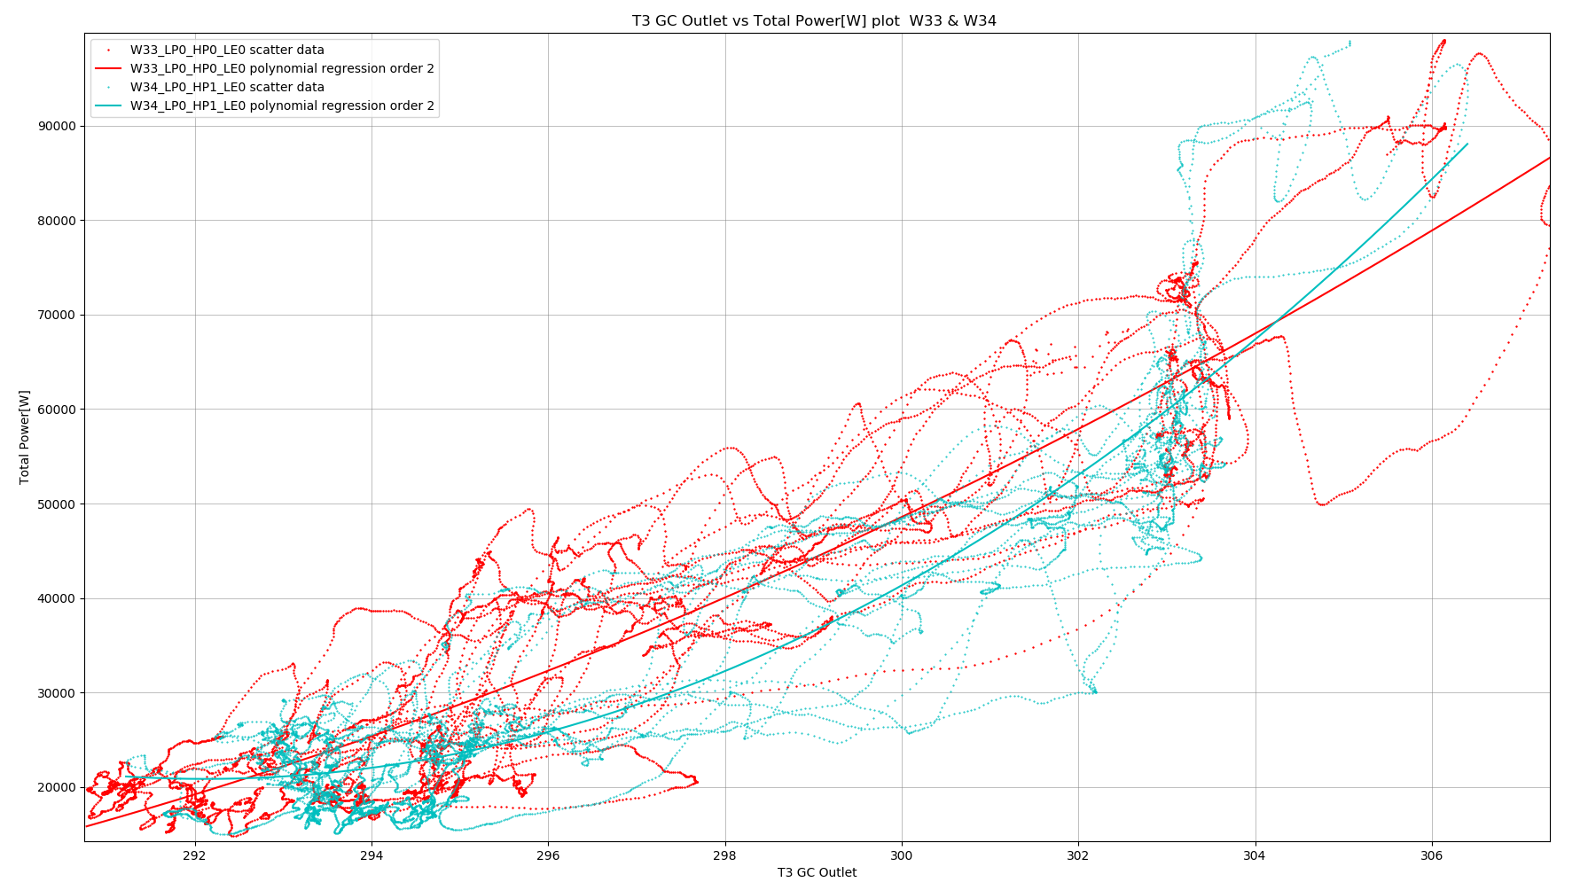
Future challenges:
HP ejector performance in low and high load
2nd law analysis for exergy destruction in every single component
Pressure control strategy for optimizing system performance

Slide 27
Piece of code to in Python for datetime to seconds and back:
""" Example for a Python Pandas dataframe datetime to seconds to datetime """
import pandas as pd
from datetime import datetime
dataframe = pd.read_csv("11_07_2019_to_18_07_2019_converted.csv", na_filter=True, skip_blank_lines=True, low_memory=False)
t0 = datetime.strptime(" 17:00:00 11/07/2019", " %H:%M:%S %d/%m/%Y") # Time refrence for date conversio for i in range(dataframe.shape[0]): DT = datetime.strptime(dataframe.loc[i][0], "%Y-%m-%d %H:%M:%S.%f") dataframe.at[i, 'Name'] = (DT - t0).total_seconds()
time = dataframe['Name'].tolist()
tb = (t0-datetime.strptime(" 01:00:00 01/01/1970", " %H:%M:%S %d/%m/%Y")).total_seconds() print('From ', datetime.fromtimestamp(time[0] + tb).strftime("%d, %B, %Y, %H:%M:%S"), ' In seconds: ', time[0]) print('To ', datetime.fromtimestamp(time[-1] + tb).strftime("%d, %B, %Y, %H:%M:%S"), ' In seconds: ', time[-1])

